Slide 1
Optical fibers and cables
Arpita howlader
Dept of Computer & Communication Engineering
Patuakhali Science and Technology University

Slide 2
Introduction
Optical fibers may be produced with good stable transmission characteristics in long lengths at a minimum cost and with maximum reproducibility.
A range of optical fiber types with regard to size, refractive indices and index profiles, operating wavelengths, materials, etc., be available in order to fulfill many different system applications.
The fibers may be converted into practical cables which can be handled in a similar manner to conventional electrical transmission cables without problems associated with the degradation of their characteristics or damage.
The fibers and fiber cables may be terminated and connected together (jointed) without excessive practical difficulties and in ways which limit the effect of this process on the fiber transmission characteristics to keep them within acceptable operating levels.

Slide 3
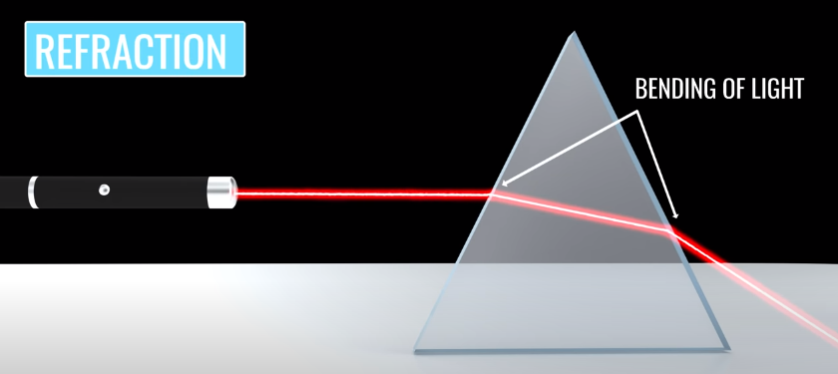

Slide 4
Preparation of optical fibers
Two-stage process in which initially the pure glass is produced and converted into a form (rod or preform) suitable for making the fiber.
A drawing or pulling technique is then employed to acquire the end product. The methods of preparing the extremely pure optical glasses generally fall into two major categories which are:
conventional glass refining techniques in which the glass is processed in the molten state (melting methods) producing a multicomponent glass structure;
vapor-phase deposition methods producing silica-rich glasses which have melting temperatures that are too high to allow the conventional melt process.

Slide 5
Liquid-phase (melting) techniques
The first stage in this process is the preparation of ultrapure material powders which are usually oxides or carbonates of the required constituents.
These include oxides such as SiO2, GeO2, B2O2 and A2O3, and carbonates such as Na2CO3, K2CO3, CaCO3 and BaCO3 which will decompose into oxides during the glass melting.
Very high initial purity is essential and purification accounts for a large proportion of the material cost
The purification may therefore involve combined techniques of fine filtration and co-precipitation
The next stage is to melt these high-purity, powdered, low-melting-point glass materials to form a homogeneous, bubble-free multicomponent glass
The melting of these multicomponent glass systems occurs at relatively low temperatures between 900 and 1300 °C and take place in a silica crucible
Silica crucibles can give dissolution into the melt , for avoiding this involves melting the glass directly into a radio-frequency induction furnace while cooling the silica by gas or water flow
After t melt has been processed, it is cooled and formed into long rods (cane) of multicomponent glass
Notes:
Barium carbonate is a white powder. It is insoluble in water and soluble in most acids, with the exception of sulfuric acid. It has a specific gravity of 4.275. It is toxic by ingestion.

Slide 6
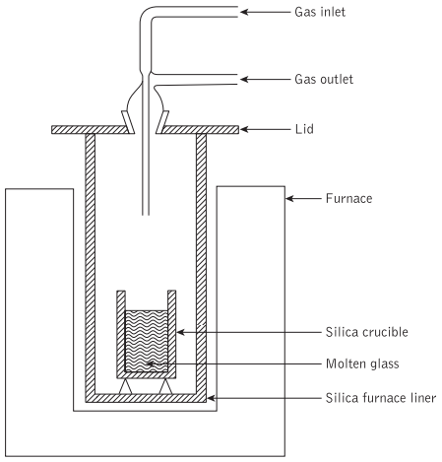
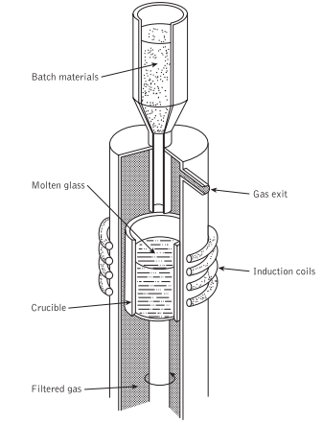
Glassmaking furnace for the production of high-purity glasses
High-purity melting using a radio-frequency induction furnace

Slide 7
Fiber drawing
An original technique for producing fine optical fiber waveguides was to make a preform using the rod in tube process.
A rod of core glass was inserted into a tube of cladding glass and the preform was drawn in a vertical muffle furnace
Subsequent development in the drawing of optical fibers (especially graded index) produced by liquid-phase techniques has concentrated on the double-crucible method.
In this method the core and cladding glass in the form of separate rods is fed into two concentric platinum crucibles
The crucibles have nozzles in their bases from which the clad fiber is drawn directly from the melt

Slide 8
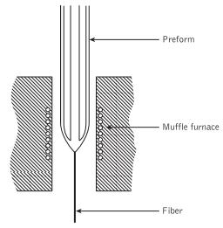
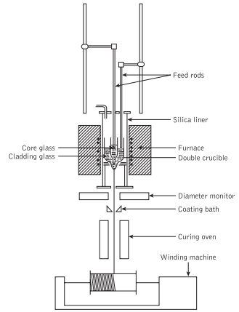
Optical fiber from a preform
The double-crucible method for fiber drawing

Slide 9
Vapor-phase deposition techniques
Vapor Phase Deposition (VPD) technique is a method of preparing the extremely pure optical glasses.
Vapor Phase methods are the ones that are now used to produce silica-based fibers with very low attenuation, highest transparency with the optimal optical properties.
Ingredients: Starting materials are volatile organic compounds such as: SiCl₄, GeCl₄, SiF₄, BCL₃, O₂, BBr₃, POCl₃
Refractive index modification is achieved through the formation of dopants from the non-silica starting materials: TiO2 ,GeO2 , P2O5,Al2O3 ,B2O3 , F

Slide 10
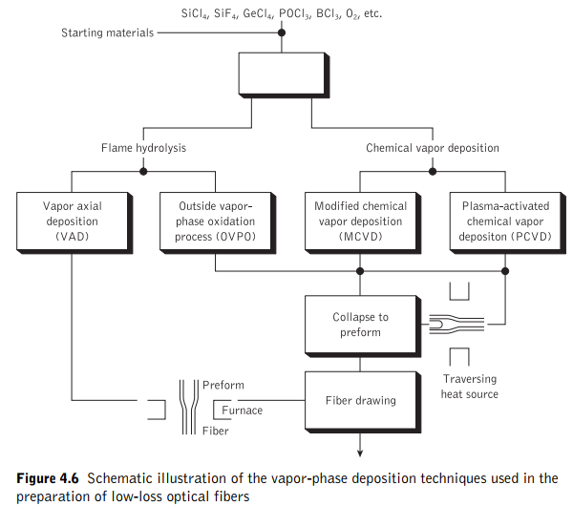
Vapor-phase deposition techniques

Slide 11
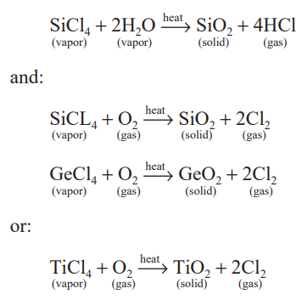
Outside vapor-phase oxidation process
Uses flame hydrolysis stems from work on soot processes which were used to produce the first fiber with losses of less than 20 dBKm⁻¹.
Oxygen is passed through the silicon compound which is vaporized, removing impurities.
Dopants are added and gave following reactions:

Slide 12
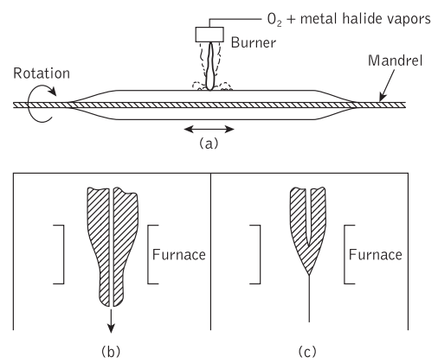
Outside vapor-phase oxidation process
The silica is regenerated as a fine soot which is deposited on a cool rotating mandrel. The flame is reversed back and forth over the length of the mandrel for getting sufficient numbers of silica layers.
After the process ends, the mandrel is removed and the porous mass of silica soot is sintered.
The preform may contain both core and cladding glasses by properly varying the dopant concentrations during the deposition process

Slide 13
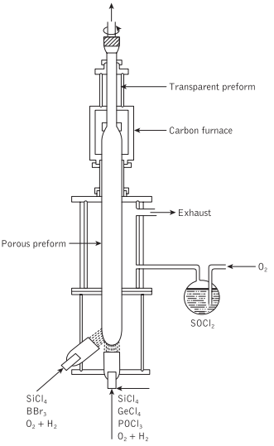
Vapor axial deposition (VAD)
Continuous technique for producing low loss optical fibers.
uses an end-on deposition onto a rotating fused silica target
Vaporized constituents are injected from burners and react to form silica soot by flame hydrolysis and makes a solid porous glass preform.
deposited on the end of the starting target in the axial direction forming a solid porous glass preform in the shape of a boule

Slide 14

Vapor axial deposition (VAD)
The preform is pulled upwards.
Dehydrated by heating with SOCl2 using the reaction:
sintered into a solid preform in a graphite resistance furnace at an elevated temperature of around 1500 °C
process may be adapted to draw fiber continuously
spatial refractive index profile may be achieved using the deposition properties of SiO₂–GeO₂ particles within the oxygen–hydrogen flame

Slide 15
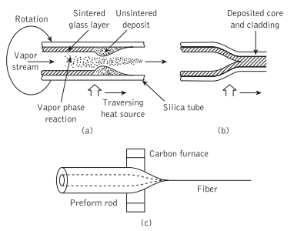
Modified chemical vapor deposition
Vapor-phase reactants (halide and oxygen) pass through a hot zone.
Glass particles formed during this reaction travel with the gas flow and are deposited on the walls of the silica tube.
The hot zone is moved back and forth along the tube allowing the particles to be deposited on a layer-by-layer basis giving a sintered transparent silica film on the walls of the tube.
Vaporized GeCl₄ and POCl₃ are added to the gas flow.

Slide 16
Modified chemical vapor deposition
The core glass is then formed by the deposition of successive layers of germane-silicate or phosphor-silicate glass.
After the deposition is completed the temperature is increased to between 1700 and 1900 °C.
The tube is then collapsed to give a solid preform which may then be drawn into fiber at temperatures of 2000 to 2200 °C.
MCVD technique has proved suitable for the widespread
mass production of high-performance optical fibers

Slide 17
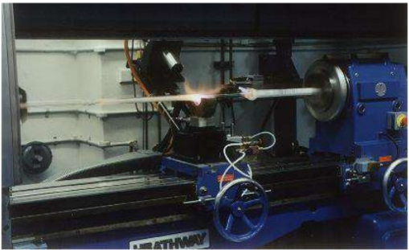
Modified chemical vapor deposition

Slide 18
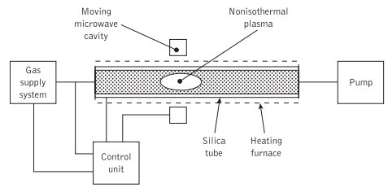
Plasma-activated chemical vapor deposition
PCVD is the stimulation of oxide formation by means of a non-isothermal plasma maintained at low pressure in a microwave cavity (2.45 GHz) which surrounds the tube.
Volatile reactants are introduced into the tube where they react heterogeneously.
The reaction zone is moved backwards and forwards along the tube by control of the microwave cavity and a circularly symmetric layer growth is formed.

Slide 19
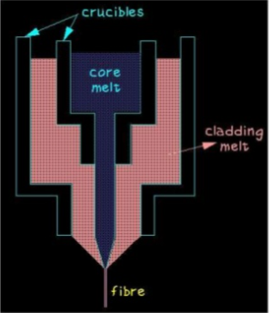
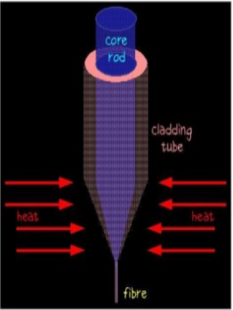
General Optical Fiber Making Process

Slide 20
Summary of vapor-phase deposition techniques
Both step index and graded index fibers are made with these processes.
Gives relatively similar performance for the fabrication of both multi-mode and single-mode fibers.
MCVD and VAD technique employed together as MCVD-VAD hybrid technique for producing polarization maintaining fiber.

Slide 21
Optical fiber cables
The functions of the optical cable may be summarized into four main areas. These are as follows:
Fiber protection. The major function of the optical cable is to protect against fiber damage and breakage both during installation and throughout the life of the fiber.
Stability of the fiber transmission characteristics. The cabled fiber must have good stable transmission characteristics which are comparable with the un-cabled fiber. Increases in optical attenuation due to cabling are quite usual and must be minimized within the cable design.

Slide 22
Optical fiber cables
The functions of the optical cable may be summarized into four main areas. These are as follows:
Cable strength. Optical cables must have similar mechanical properties to electrical transmission cables in order that they may be handled in the same manner. These mechanical properties include tension, torsion, compression, bending, squeezing and vibration. Hence the cable strength may be improved by incorporating a suitable strength member and by giving the cable a properly designed thick outer sheath.
Identification and jointing of the fibers within the cable. This is especially important for cables including a large number of optical fibers. If the fibers are arranged in a suitable geometry it may be possible to use multiple jointing techniques rather than jointing each fiber individually

Slide 23
Micro bending
Certain problems can occur either within the cabling process which is the meandering of the fiber core axis on a microscopic scale within the cable form, known as micro bending
This problem can be generated at any stage during the manufacturing process, the cable installation process or during service, small lateral forces exerted on the fiber during the cabling process
it causes losses due to radiation in both multimode and single-mode fibers where losses caused by fiber stress and deformation on a micron scale
Micro bending losses are mode dependent and wavelength dependent
The first form occurs when a fiber is excited by a diffuse Lambertian source, launching all possible modes, and is referred to as a uniform or fully filled mode distribution.
The second form occurs due to a significant amount of mode coupling and mode attenuation, referred to as a steady state or equilibrium mode distribution

Slide 24
Cable design
The cable must be designed so that the strain on the fiber in the cable does not exceed 0.2%
Alternatively, it is suggested that the permanent strain on the fiber should be less than 0.1%
In practice, these constraints may be overcome in various ways which are, to some extent, dependent upon the cable’s application.
Cable design may generally be separated into a number of major considerations.
Fiber buffering,
Cable structural and strength members
Cable sheath, water barrier and cable core

Slide 25
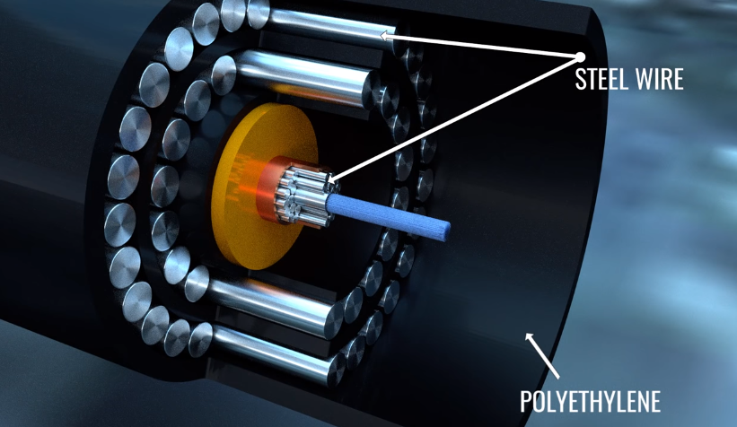
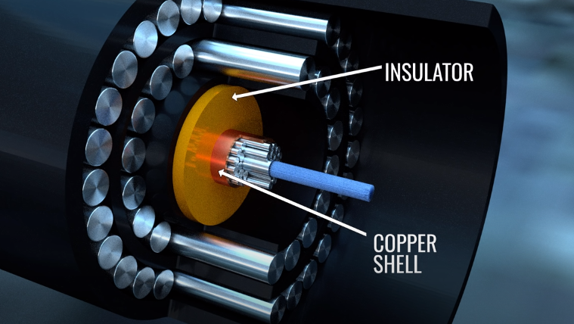
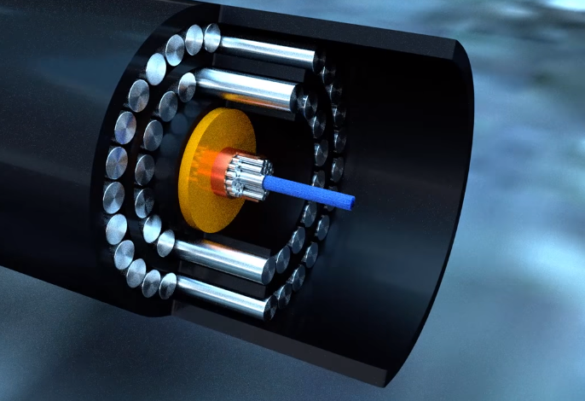

Slide 26
Fiber Buffering
Fiber is given a primary coating (jacket) during production (typically 5 to 10 μm of Teflon) in order to prevent abrasion of the glass surface and subsequent flaws in the material.
The primary coated fiber is then given a secondary or buffer coating (jacket) to provide protection against external mechanical and environmental influences.
Buffer jacket is designed to protect the fiber from micro-bending losses and may take several different forms
These generally fall into one of three distinct types
Tight buffer jacket;
Loose tube buffer jacket;
Filled loose tube buffer jacket

Slide 27
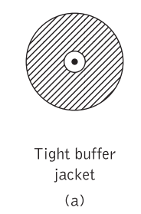
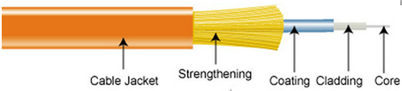
Fiber Buffering
Tight buffer jacket:
consists of a hard plastic (e.g. nylon, Hytrel, Tefzel) and is in direct contact with the primary coated fiber
which has a typical diameter of 250 μm.
This thick buffer coating (usually 900 μm in diameter) provides stiffening for the fiber against outside micro-bending influences,
but it must be applied in such a manner as not to cause micro-bending losses itself

Slide 28
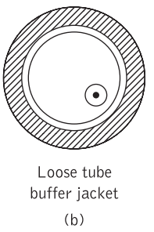
Fiber Buffering
Loose tube buffer jacket:
Produces an over sized cavity in which the fiber is placed and which mechanically isolates the fiber from external forces.
Generally achieved by using a hard, smooth, flexible material, or combination of materials (e.g. polyester and polyamide)
Outer diameter of typically 1.4 mm.
As smooth inside, exhibits a low resistance to movement of the fiber.
Can be easily stripped for jointing or fiber termination.

Slide 29
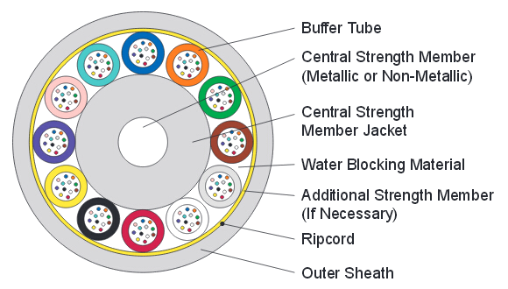
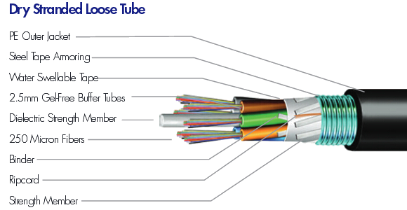
Fiber Buffering

Slide 30
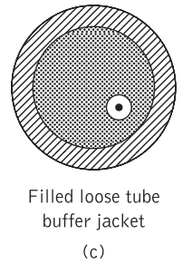
Fiber Buffering
Filled loose tube buffer jacket: over sized cavity is filled with a moisture-resistant compound
which combines the advantages of the previous methods, also provides a water barrier in the immediate vicinity of the fiber.
must be soft, self-healing and stable over a wide range of temperatures (i.e. it should not drip out or freeze between −30 and +70°C),
consists of specially blended petroleum or silicon-based compounds

Slide 31
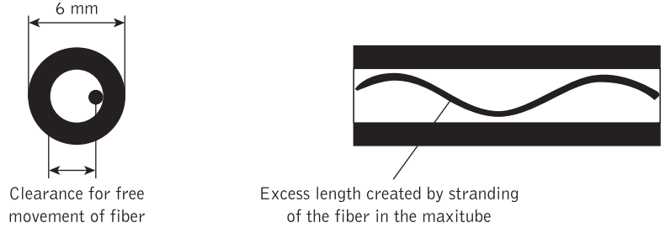
Fiber Buffering
Maxitube loose buffer :
comprises a larger buffer jacket with an outside diameter of typically 6 mm,
inside which a greater number of either individual fibers or fibers in the form of bundles or ribbon structures can be placed
Optical fibers located inside the multi-fiber maxi-tube are stranded and through this process an excess length of approximately 0.5% can be obtained

Slide 32
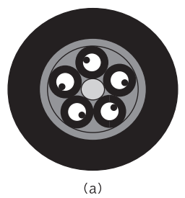
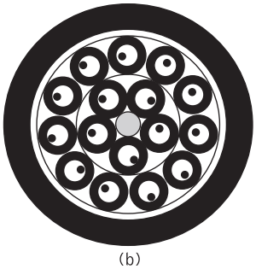
Cable structural and strength members
One or more structural members are usually serve as a cable core foundation around which the buffered fibers may be wrapped, or into which they may be slotted.
This approach, which is referred to as stranding:
When the stranding is composed of individual elements (e.g. single-fiber or multi-fiber loose tube buffer, or a maxitube) then the cable is described as a layer cable
(a) one-layer cable incorporating single fiber loose tube buffers;
(b) layer cable incorporating single-fiber loose tube buffers in two layers;

Slide 33
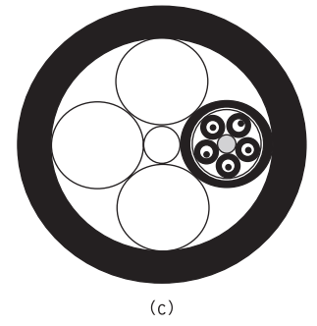
Cable structural and strength members
Cable core consists of stranding elements as a unit of stranded elements, termed an optical unit cable shown in Figure(c)
Enables increased fiber packing density.
Central steel member acts as both a structural and strength member.
Structural member may also be a strength or tensile member if it consists of suitable material such as solid or stranded steel wire, dielectric aramid yarns
In these cases the central steel member
is the primary load-bearing element
providing strain relief.

Slide 34
Cable structural and strength members
A slotted core cable which comprises a special design of layer cable with a single layer incorporating an extruded plastic structural member around a central steel wire strength member
Case optical fiber ribbons lie in helical grooves or slots formed in the surface of the structural member rather than the fibers being inside buffer jackets and stranded in layers.
Moreover, the primary function of the structural member is therefore not load bearing, but to provide suitable accommodation for the fiber ribbons within the cable.
It should be noted that although the overall fiber count provided by this cable is 100, a unit cable construction using a similar element can incorporate 1000 fibers

Slide 35
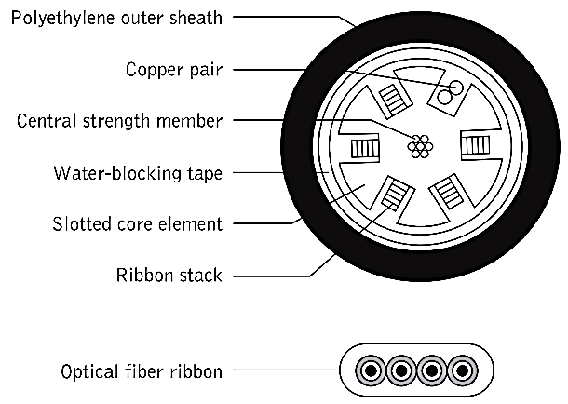
Cable structural and strength members
Slotted core cable with four fiber ribbons incorporating a total of 100 fibers

Slide 36
Cable sheath, water barrier and cable core
Covered with a substantial outer plastic case to reduce friction and to give protection against external mechanical effects such as crushing.
Cable case contains cable core and
complex from a single extruded plastic jacket
multilayer structure consisting of two or more jackets with intermediate armor or wrapper
The common and well-proven polyethylene (PE) sheath material is most often utilized, while polyvinyl chloride (PVC) finds frequent application for indoor cables
Water barrier is incorporated for outdoor cables

Slide 37
Cable sheath, water barrier and cable core
Alternatively, the ingress of water may be prevented by filling the spaces in the cable with moisture-resistant compounds
such as silicone rubber or petroleum-based compounds are often used
filling compounds are also easily removed from the cable and provide protection from corrosion for any metallic strength members within the fiber
if filled cables are required to have a metal-free sheath construction, then a barrier plastic layer comprising, for example, polyimide–thermoplastic adhesive can be incorporated between the cable sheath and filling compound
This prevents migration of the filling compound into the sheath from the cable core.

Slide 38
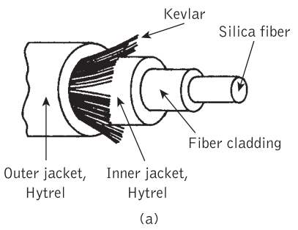
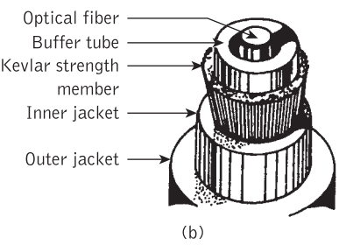
Examples of fiber cables
Two examples of cable construction for single fibers
Fig (a) 250 μm diameter fiber protected by a tight buffer jacket and surrounded by a layer of Kevlar for strength and outer cable jacket with a typical diameter of 2.4 mm is provided
Fig (b) uses a loose tube buffer surrounded by a Kevlar strength member which is protected by an inner sheath or jacket before the outer sheath layer

Slide 39
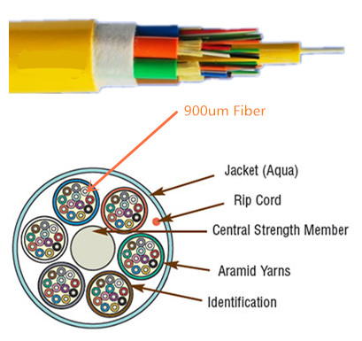
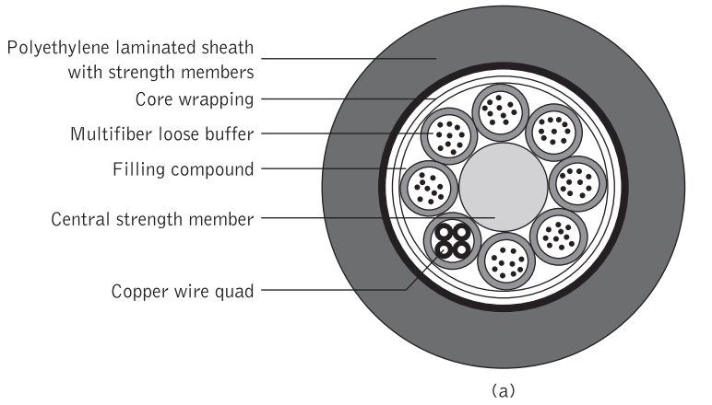
Examples of fiber cables

Slide 40
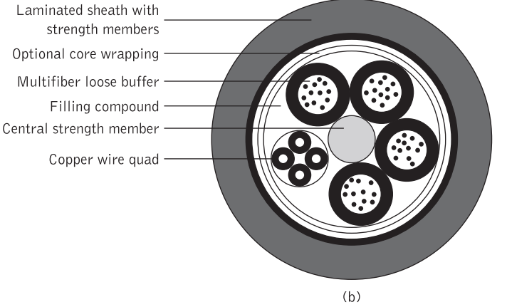
Examples of fiber cables
This type of layered cable design with loose tube buffers incorporating between 2 and 12 single-mode fibers per tube predominates in the core telecommunications network

Slide 41
THANKS It Feels Good When You Understand

